Slide 1


Cyber Security for Digital Devices
Internet and World Wide Web and cyber security
Name : Divesh Jadhwani
Institution : Pimpri Chinchwad University

Slide 2
Differences Between the Internet and the Web
Internet: A global network of interconnected computers.
Functions: Data transfer, email, file sharing.
World Wide Web (WWW): A system of interlinked hypertext ( text which contains links to other texts)documents accessed via the internet.
Functions: Browsing web pages, accessing online services.

Slide 3


Advent of the Internet
1960s: Originated as ARPANET.
1980s: Expansion beyond academic and military use.
1990s: Commercialization and widespread public adoption.

Slide 4
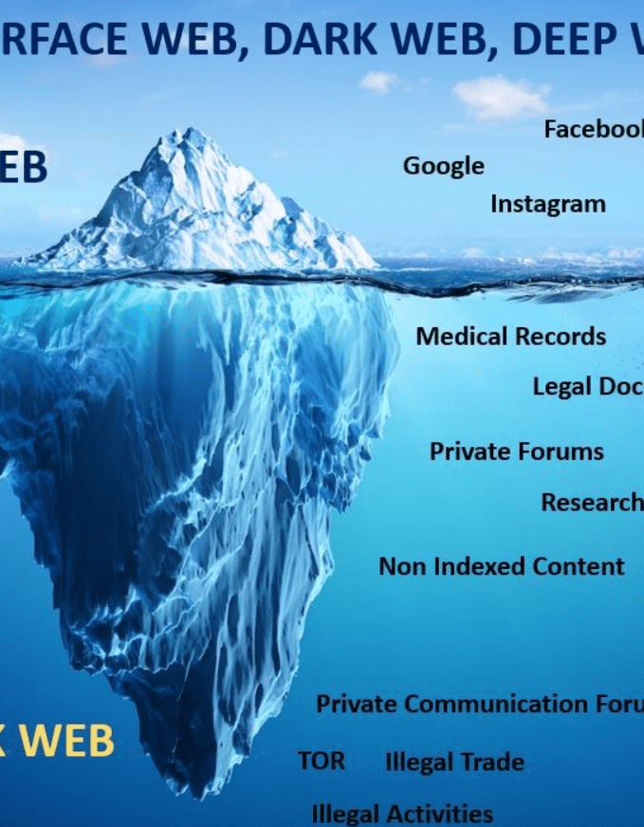
Key Components of the Web
Web Browsers: Software to access web pages (e.g., Chrome, Firefox , TOR).
Web Servers: Computers hosting websites.Https requests and response.
URLs: Addresses of web resources.
HTML: Scripting Language for creating web pages.
HTTP/HTTPS(HyperText Transfer Protocol Secure): Protocols for data transfer on the web.

Slide 5
Internet Governance
Definition:
The development and application of shared principles, norms, rules, decision-making procedures, and programs that shape the evolution and use of the internet.
This means making rules and guidelines to keep the internet safe and working well.
Goals: Security, stability, and resilience(recovery) of the internet.

Slide 6

Key Organizations in Internet Governance:
ICANN (Internet Corporation for Assigned Names and Numbers)
Role: Manages the global domain name system (DNS) and IP address allocation.
Example: Ensures that every website address is unique and can be found on the internet.
IETF (Internet Engineering Task Force)
Role: Develops and maintains the technical standards that make the internet work.
Example: Creates protocols like HTTP, which allows web browsers and servers to communicate.
ISOC (Internet Society)
Role: Supports for policies that support an open and accessible internet.
Example: Works on issues like internet accessibility and online privacy.

Slide 7
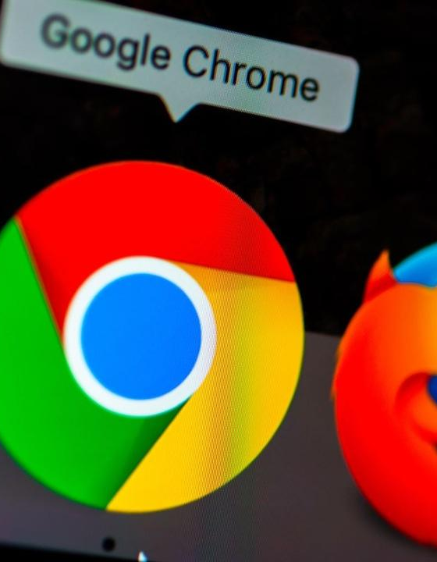
Internet Society
Internet Society (ISOC): Global organization promoting the open development, evolution, and use of the internet.
Activities: Advocacy (public support), education, and community building.

Slide 8
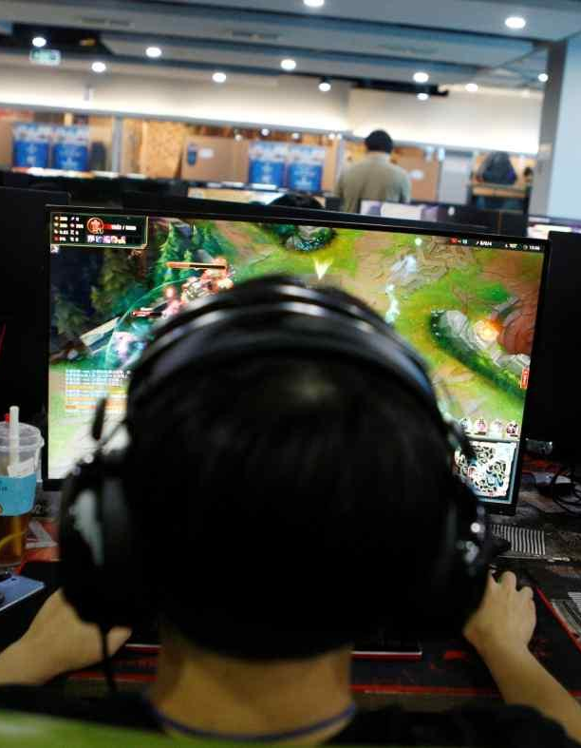
Regulatory Bodies and Frameworks
ICANN: Internet Corporation for Assigned Names and Numbers.
IETF: Internet Engineering Task Force.
National Regulations: Varies by country (e.g., FCC in the USA).

Slide 9
Challenges in Regulating Cyberspace
Jurisdictional Issues: Internet crosses national borders.
PROBLEM : Different countries have different laws and rules about what you can and can't do online.
Eg . A website might be legal in one country but illegal. in another, making it hard to regulate.
Privacy Concerns: Balancing surveillance and user privacy.
PROBLEM : Governments and companies want to watch what people do online to prevent bad things (like crimes) from happening. But people also want to keep their personal information secret and not be constantly watched.
eg: Using cameras to catch thieves is good for safety, but having cameras everywhere might make people feel like they have no privacy.
Cybercrime : Evolving threats and enforcement difficulties.
PROBLEM : The ways criminals use the internet keep changing and getting more sophisticated. It's hard for police and other authorities to keep up and catch them, especially since these criminals can be in any country.
Eg : A hacker in one country might steal credit card information from people in another country, making it hard for local police to catch them.

Slide 10

Introduction to Cyber Security
Definition: The practice of protecting systems, networks, and programs from digital attacks.
Scope: Encompasses technologies, processes, and controls.

Slide 11
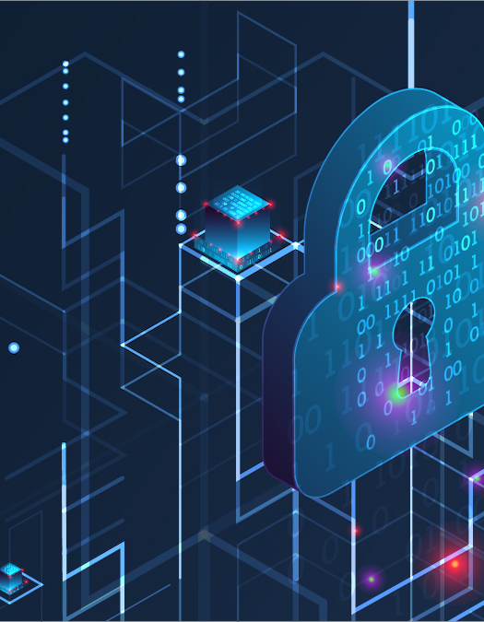
Importance of Cyber Security in Modern Society
Protection of Sensitive Data: Prevents data breaches.
Maintaining Trust: Ensures user confidence in online services.
Economic Impact: Avoids financial losses due to cyber attacks.

Slide 12
Key Concepts and Terminologies
Malware: Malicious(a desire to cause harm to someone) software designed to harm.
Phishing: Fraudulent attempts to obtain sensitive information.
Encryption: Converting data into a secure format.
Firewall: Network security system that monitors and controls incoming and outgoing network traffic.

Slide 13
MCQ Quiz Introduction
Quiz Time!
Answer the following multiple-choice questions to test your understanding.

Slide 14
MCQ Question 1
What is the main function of the internet?
a) Browsing web pages
b) Data transfer and communication
c) Creating websites
d) Hosting servers

Slide 15
MCQ Question 2
Which organization is responsible for managing domain names and IP addresses?
a) ISOC
b) IETF
c) ICANN
d) FCC

Slide 16
MCQ Question 3
What does 'malware' refer to?
a) A network security system
b) Fraudulent email attempts
c) Malicious software
d) Secure data format

